Slide 1



healthfinder.gov and social media
Presented to:
Maryland County Interagency Coalition on
Adolescent Pregnancy
Ellen Langhans, MA and Silje Lier, MPH
June 18, 2013

Slide 2
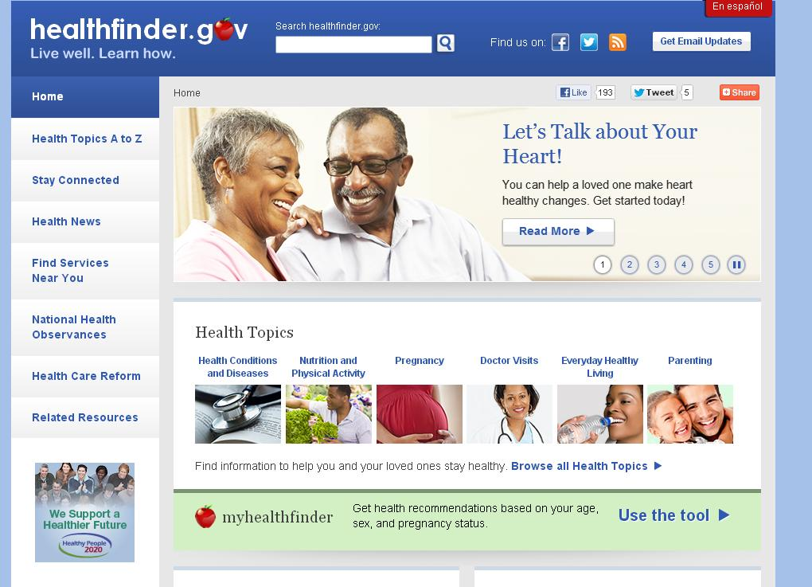
healthfinder background
Designed for users with low health literacy
Evidence-based prevention focus
Wellness: Health Topics
A-Z
Preventive Services: myhealthfinder

Slide 3
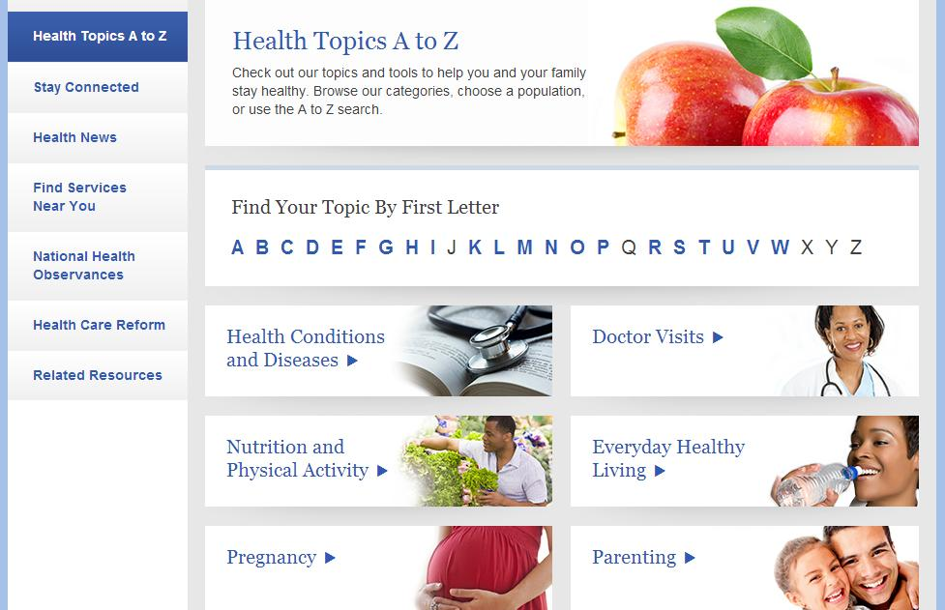
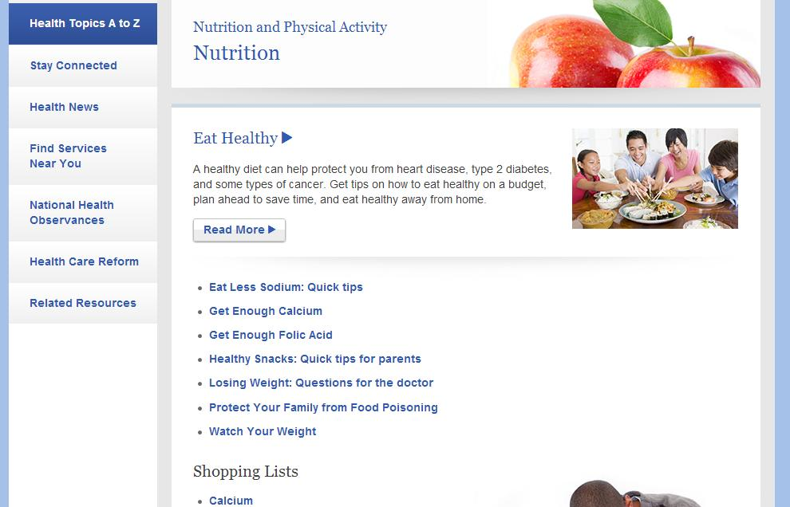
Health Topics A-Z

Slide 4
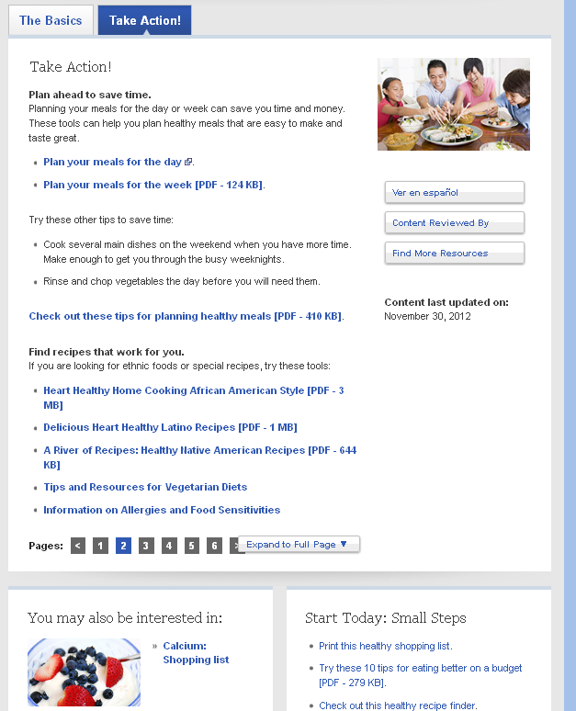
Health Topics A-Z
NHLBI
NHLBI’s
We Can
NHLBI
USDA
Dietary Guidelines
ChooseMyPlate
USDA
Notes:
healthfinder’s Health Topics A-Z synthesizes information from across HHS and boils prevention information down to the basics:
What you need to know,
Why it’s important, and
How to take action

Slide 5
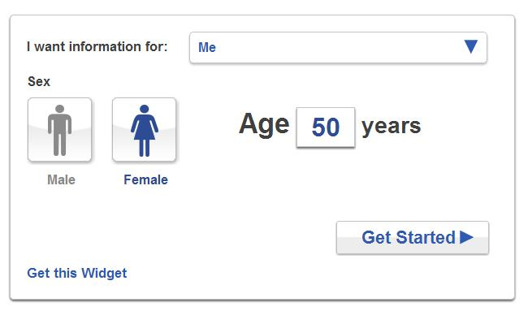
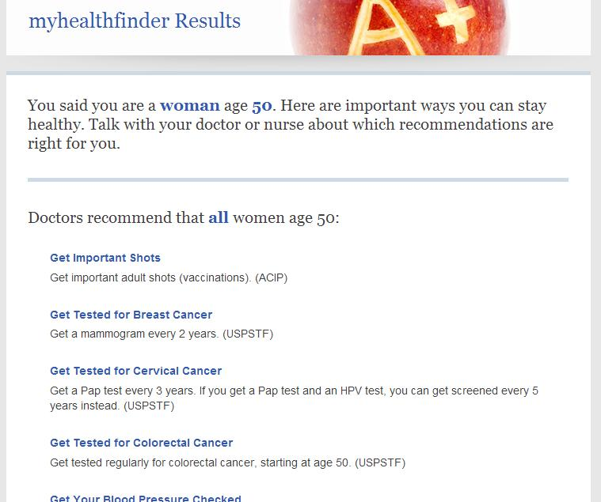
myhealthfinder

Slide 6
healthfinder.gov outreach strategy
    The mission of healthfinder is to help the public make informed health decisions by providing accurate, timely, and actionable information
      Increase consumer understanding of/action upon the key principals of healthy living
      Build consumer confidence that health behavior change is personally attainable
      Build an online presence that supports individuals in attaining healthy living and wellness goals through accountability and encouragement
      Provide decision support around the preventive services available to users (and covered by ACA)
Notes:
Provide clear and simple messages that motivate behavioral change; tie in to personal benefits
Provide actionable steps for consumers to successfully adopt
Provide opportunities for community members to engage with one another via Facebook, Twitter, email, and hf.gov
Provide resources (myHF) that help community members take advantage of preventive services and communicate with their health care provider.

Slide 7


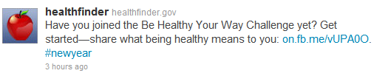
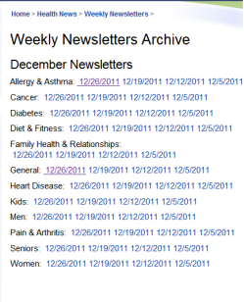
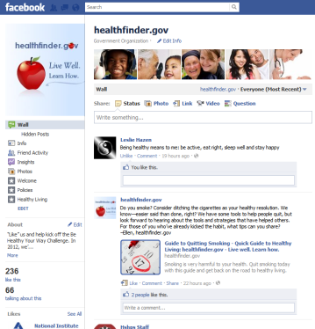
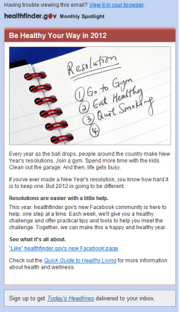


healthfinder Strategy Visual
HF In the Know
@healthfinder tweet
Web site content
Facebook community
Weekly Newsletters
HF Monthly Spotlight
@gohealthypeople tweet

Slide 8
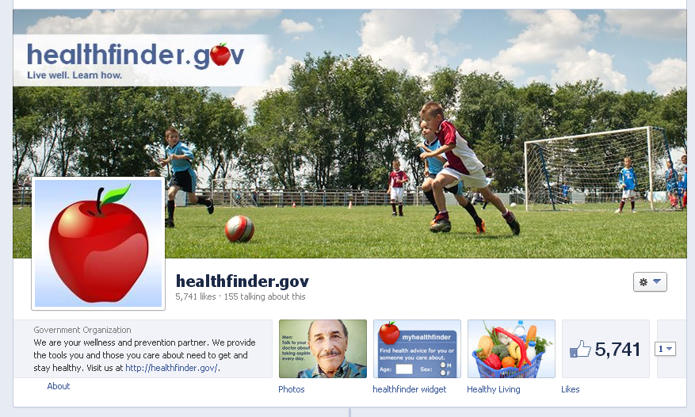
healthfinder.gov on Facebook

Slide 9

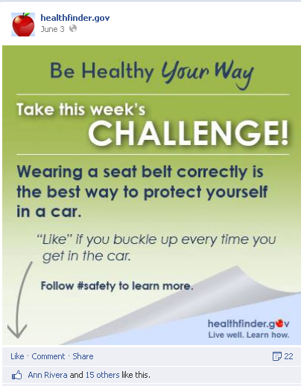
Facebook Weekly Themes
Men’s Health Week
June 10 – June 14
Safety
June 3 – June 7

Slide 10
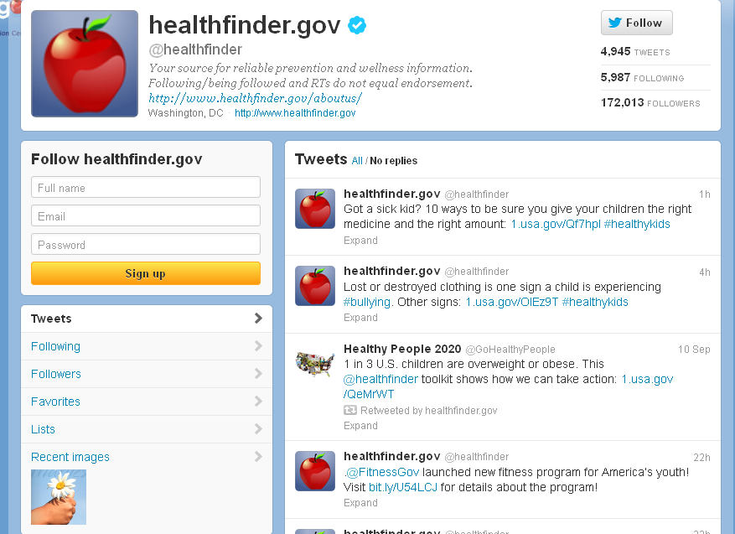

Slide 11
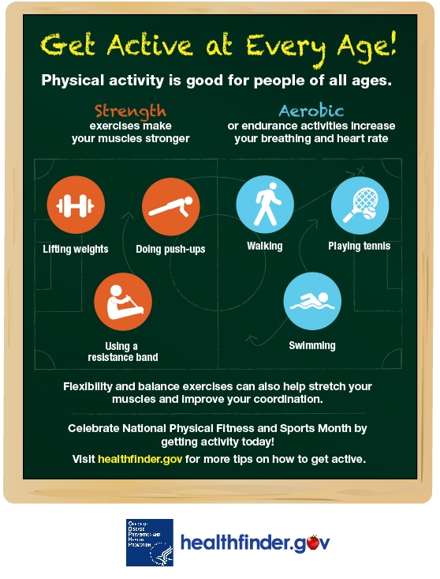
Monthly Spotlight

Slide 12
Outreach and Engagement
Reach
Engagement
  healthfinder users
  Emails
  Tweets
  Facebook posts
  Web interactions
  Email clicks
  Retweets
  Twitter faves
  Facebook likes
  Facebook comments
  Facebook shares

Slide 13
Engage People Where They Are
Why?
  Interactive participation and engagement
    From passive recipients to active, engaged producers of information
  Peer-to-peer communication & social support
  Feedback Loop
  Viral Dissemination
How?
  Co-Host & Collaborate on Online Events
  Engage Influencers and Opinion Leaders
  Facilitate Online Conversations
    Example: Questions, Retweets
  Promote health content around events or National Health Observances

Slide 14
Social Media Resources
http://newmedia.hhs.gov/
http://www.cdc.gov/healthcommunication/ToolsTemplates/SocialMediaToolkit_BM.pdf
http://www.howto.gov/social-media
Notes:
New Media and HowTo.gov have great posts on looking at social media metrics. HowTo.gov also features training on different social media uses.

Slide 15
Thank You
  Ellen.Langhans@hhs.gov
  @elanghans
  Silje.Lier@hhs.gov
  @sealya

