Slide 1
Fathers Speak Up: From Teen Fathers to Community Leaders
Moderator: Hector Sanchez-Flores
and panelist from the
National Compadres Network/
National Latino Father and Families Institute
May 30, 2013
Elders Speak Up… Fathers Stand Up… Young Men Show Up

Slide 2
Panel Objectives:
By the end of this session, participants will be able to:
Acknowledge the reality that teen fathers face in stepping up to their roles as fathers.
Understand the barriers and obstacles teen fathers face.
Learn steps on how to engage and build connections with teen fathers.
Commit to providing services that honor teen fathers and their needs
"Educational or instructional materials referenced during this presentation are for informational purposes only. Presenters' references to these materials do not constitute endorsement by FYSB. Any statements expressed are those of the presenters and do not necessarily reflect the views of FYSB."

Slide 3
Panelist
Moderator:
Hector Sanchez- Flores
Luis Cardona
Osvaldo “Ozzie” Cruz
Mario Ozuna-Sanchez

Slide 4
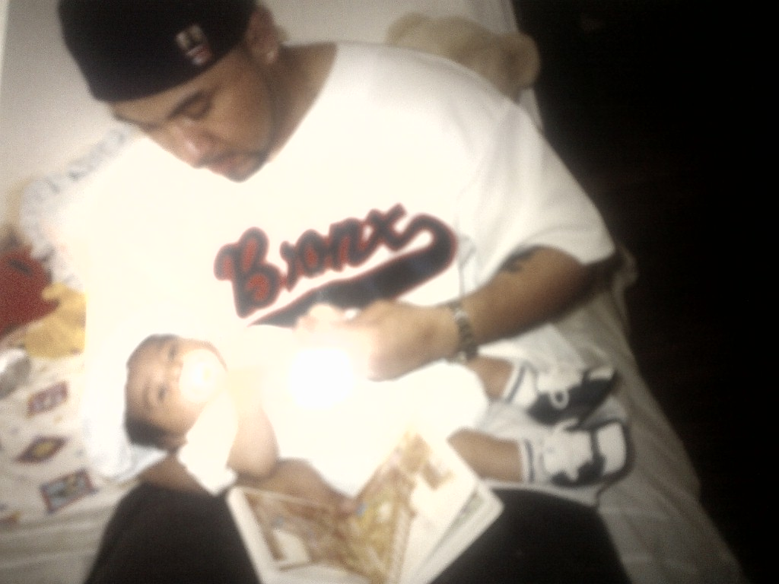
Luis Cardona- Montgomery County, Maryland

Slide 5
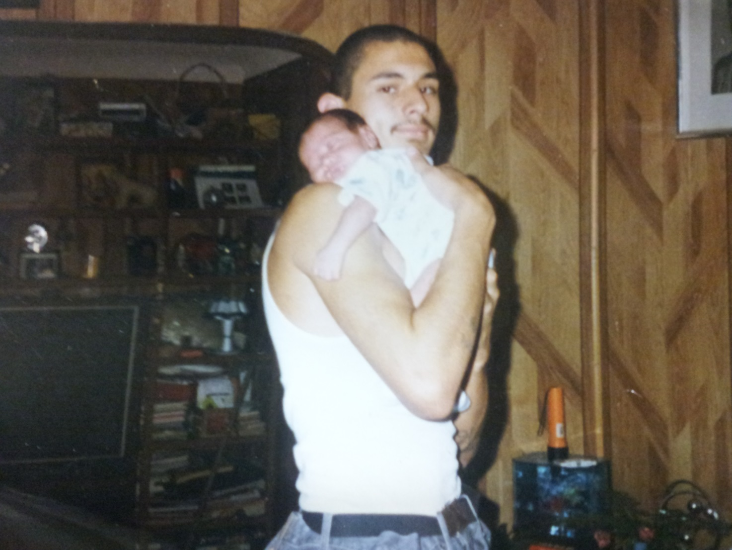
Osvaldo Cruz- Southern California

Slide 6
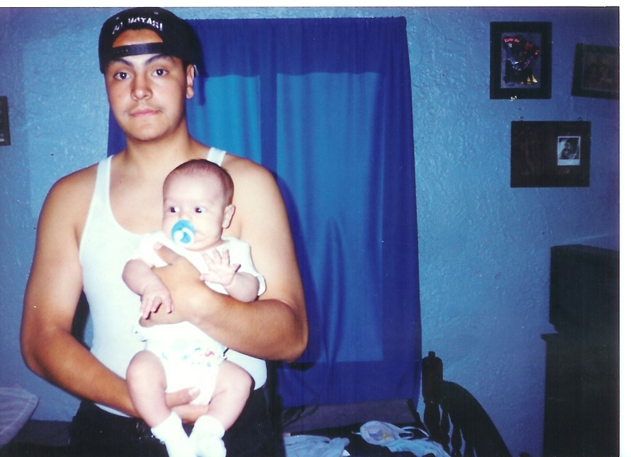
Mario Ozuna-Sanchez- Northern California

Slide 7
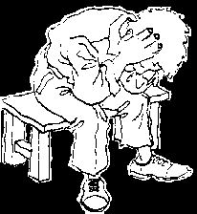
Common Obstacles for Teen Fathers
Violence at home and in the streets
Drug and alcohol abuse
Single parent families
Gangs
Foster care placements
No positive adult role models
Dysfunctional homes
Lack of employment for minors
Lack of male friendly services

Slide 8
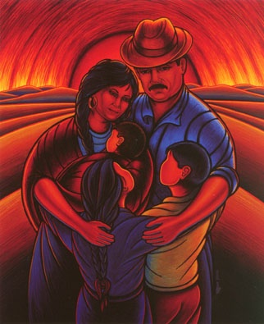
What do young fathers need?
Conocimiento (Acknowledgement)
Values
Sacred Purpose
Security
© Jerry Tello El Joven Noble

Slide 9
What should service providers do?
Talking circles that provide a safe place to share
Positive adult mentors
Holistic services that meet their needs
Purpose driven services
Practical life development
Employment readiness services

Slide 10
National Compadres Network
The National Compadres Network is a national effort whose focus is the reinforcement of positive involvement of Latino Males in the lives of their families, communities and society.
Based on the principles of “Un Hombre Noble” (A Noble Man), the mission of the National Compadres Network is to strengthen, rebalance, and redevelop the traditional Chicano/Latino “compadre” extended family system by encouraging, supporting and re-rooting the positive involvement of males in our families and community and preventing/reducing the incidence of alcohol, substance abuse, family/community violence and other oppressive behaviors.

Slide 11
National Latino Fatherhood and Family Institute
The National Latino Fatherhood and Family Institute brings together nationally recognized leaders in the fields of Latino health, education, social services, and community outreach. Our mission is to build upon Latino cultural strengths and traditions and offer a path for men of all ages to become Un Hombre Noble, or A Noble Man.

Slide 12
Latino Fatherhood Tools
The National Latino Fatherhood and Family Institute has developed a Fatherhood Toolkit, brochures, and posters addressing unique Latino cultural issues for use by practitioners across the country.
Toolkit:
Fatherhood Lessons
Posters:
Fatherhood Lessons (Lessons to Live By)
A Noble Man
A True Macho
Your True Work

Slide 13
For Further Assistance
Tel. (213) 325-1699
Northern California Office: National Compadres Network 1550 The Alameda, Suite 303 San Jose, CA 95126-2304 Southern California Office: National Compadres Network 7648 Greenleaf Avenue Whittier, CA 90602-1625

